Slide 1
GLOBALCODE // CAPSTONE PROJECT
IoT Smart Home
Automation System
Real-Time Appliance Control & Safety Monitoring
Raspberry Pi · Flask · IoT Push Notifications

Slide 2
Where we're headed
Agenda
01
Problem Statement
06
Safety System
02
Solution Overview
07
IoT Notifications
03
System Architecture
08
Live Demo
04
Hardware Components
09
Recommendation & Future Work
05
Software & Web Interface
10
Q&A
IoT Home Automation
02 / 12

Slide 3
Why this project exists
The Problem
Traditional homes lack intelligent monitoring and control.
Manual.
“
How can we make homes smarter, safer, and more responsive using affordable technology?
Lights, fans, and appliances require physical interaction to operate.
Disconnected.
There's no remote access , you must be home to control anything.
Blind.
Fire and gas leaks go undetected until it's already too late.
Silent.
Homeowners get no instant alert when a hazard occurs while away.
IoT Home Automation
03 / 12

Slide 4
What we built
Our Solution
A complete IoT smart-home system built around six core capabilities:
CONTROL
FIRE
GAS
Remote Appliance Control
Flame Detection
Gas Detection
Toggle lights, fan, and sound system from any device on the network.
IR flame sensor triggers an instant alarm the moment fire is detected.
MQ-series gas sensor watches continuously for hazardous leaks.
ALARM
ALERT
UI
Automatic Alarm
IoT Push Notifications
Web Dashboard
The sound sysconfirmedtem activates on its own the moment danger is.
Real-time alerts land on your phone via ntfy.sh, wherever you are.
A responsive, animated control panel reachable from any browser.
IoT Home Automation
04 / 12

Slide 5
How it all connects
System Architecture
Web Browser — Home Control Dashboard (any device, local network)
↓ HTTP REST API
RASPBERRY PI
Flask Web Server — app.py
Hardware Layer — hardware.py (gpiozero + threading)
↓ GPIO PINS
Room Light
Hall Light
Sound System
GPIO 17
GPIO 27
GPIO 22
Fan (DC Motor)
Flame Sensor
Gas Sensor
GPIO 12
GPIO 23
GPIO 24
↓ ON ALARM
ntfy.sh — Push Notification to Phone
IoT Home Automation
05 / 12

Slide 6
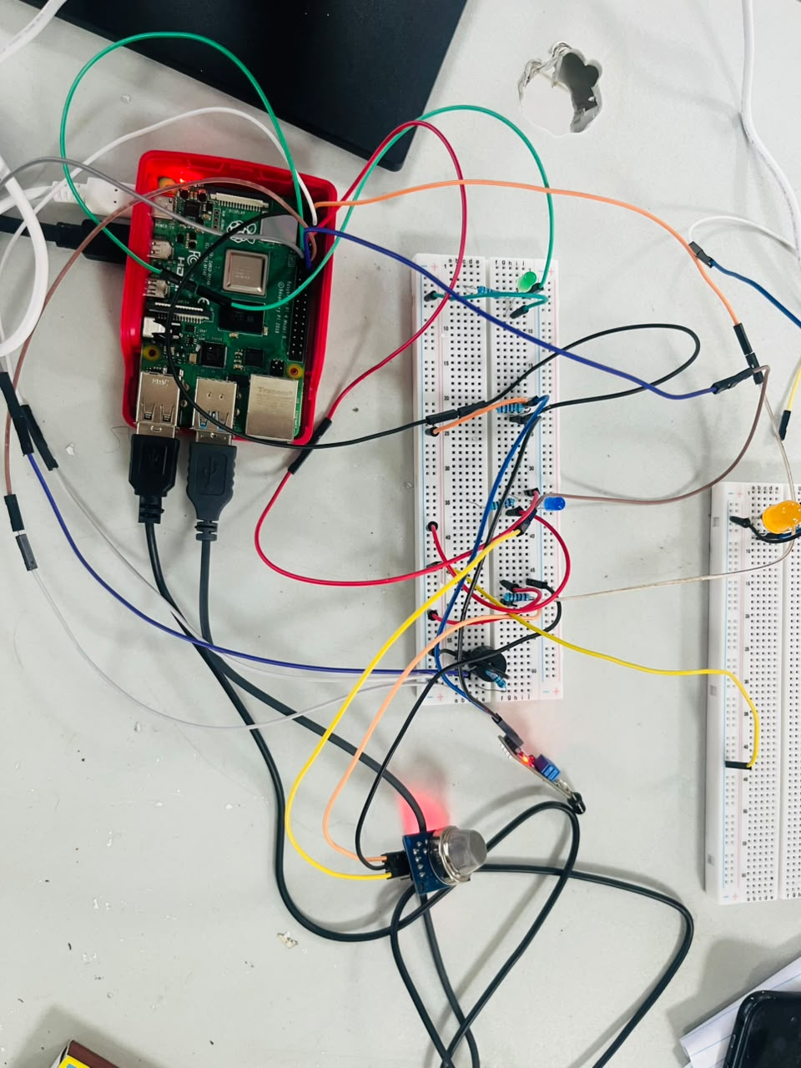
The physical layer
Hardware Components
Component | Purpose | GPIO Pin
Raspberry Pi | Central processing unit & web server | —
Blue LED | Room Light indicator | GPIO 17
Green LED | Hall Light indicator | GPIO 27
Buzzer / Relay | Sound System (alarm output) | GPIO 22
Yellow LED | Comes on when the alarm triggers | GPIO 12
IR Flame Sensor | Fire detection (digital output) | GPIO 23
MQ Gas Sensor | Gas leak detection (digital output) | GPIO 24
Breadboard & Jumpers | Circuit prototyping | —
Wiring
Outputs (LEDs, motor, buzzer) — Pi GPIO drives the component directly. Inputs (flame, gas) — sensor's digital-out pin feeds back into Pi GPIO. Power — all sensors run from the Pi's 3.3V or 5V rail.
IoT Home Automation
06 / 12

Slide 7
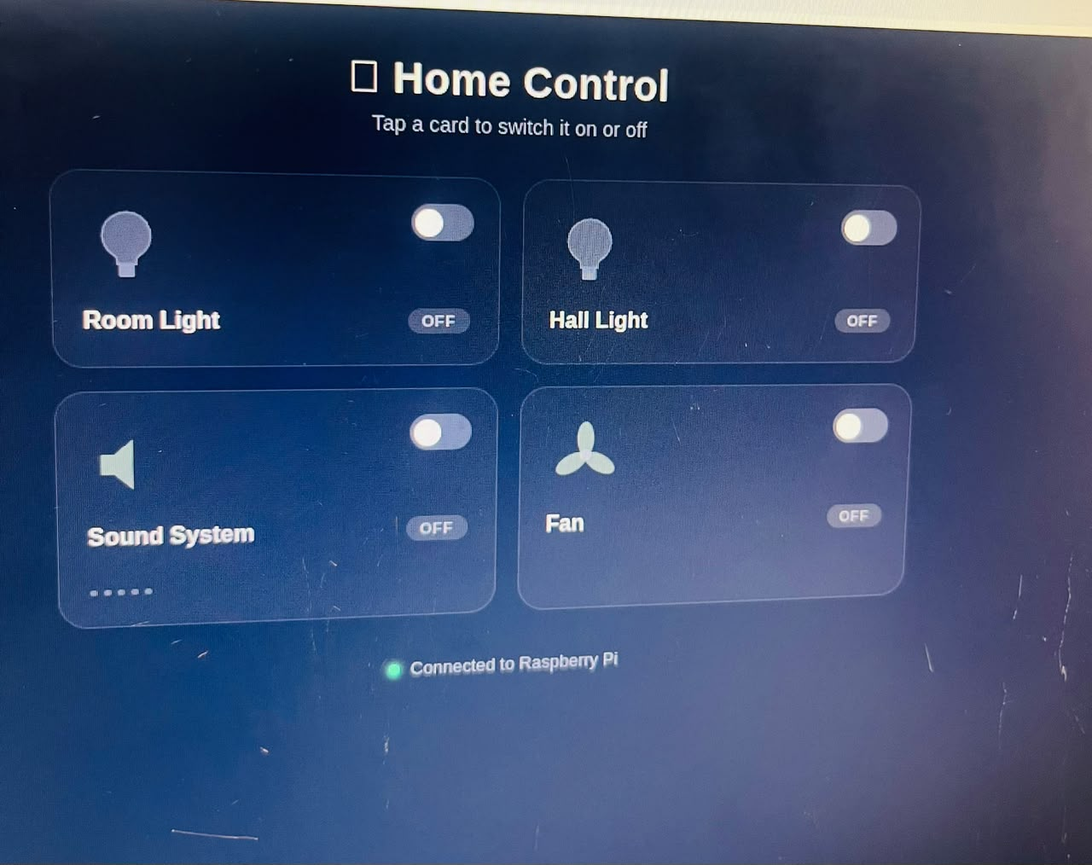
The code and the dashboard
Software & Web Interface
Layer | Technology | Purpose
Backend | Python 3 + Flask | Web server & REST API
Hardware | gpiozero + RPi.GPIO | GPIO pin management
Frontend | HTML5 + CSS3 + JS | Responsive web dashboard
IoT | ntfy.sh (HTTP POST) | Push notifications
Concurrency | Python threading | Background sensor polling (100ms)
IoT Home Automation
07 / 12

Slide 8
Flame & gas detection
Safety Detection System
Dual-sensor monitoring: a background thread polls both sensors every 100ms for instant response.
Sensor | Detection Method | Trigger Condition
IR Flame Sensor | RPi.GPIO digital read | GPIO.input(23) == GPIO.LOW
MQ Gas Sensor | gpiozero InputDevice | is_active == True
When an alarm triggers, the system automatically:
01
Sounds the alarm
02
Flags the dashboard
03
Notifies your phone
04
Names the threat
The sound system (buzzer) activates immediately.
A flashing red banner covers the web UI.
A push alert is sent instantly via ntfy.sh.
“FLAME DETECTED” vs “GAS DETECTED” shown clearly.
“
The web alarm shows a red pulsing overlay with a clickable banner — dismissing it also turns off the sound system.
IoT Home Automation
08 / 12

Slide 9
Alerts on your phone
IoT Push Notifications
Built on ntfy.sh — a free, open-source push service. No app development required; alerts land on Android, iOS, or desktop over plain HTTP.
Sensor
Triggered
Python
HTTP POST
ntfy.sh
Cloud
Phone
Alert
→
→
→
Key Features
URGENT
TAGGED
Urgent priority — bypasses Do Not Disturb on the phone.
Alerts are categorized with fire / warning tags.
UTF-8
TIMEOUT
Notification body is UTF-8 encoded, so emoji render fine.
5-second timeout — a dead network never blocks the system.
IoT Home Automation
09 / 12

Slide 10
Seeing it work
Live Demonstration
01
02
03
Appliance Control
Safety Demo
Multi-Device Sync
Open the dashboard on a phone or laptop
Toggle Room Light — watch the LED respond
Toggle the Fan — watch the DC motor spin
Toggle the Sound System — hear the buzzer
Trigger the gas sensor
Watch the red alarm banner appear
Show the push notification arriving on the phone
Dismiss the alarm from the web UI
Open the dashboard on two devices at once
Toggle a device from one screen
Watch it update live on the other
IoT Home Automation
10 / 12

Slide 11
What we learned, what's next
Future Work
Short-term
Medium-term
Long-term
Camera integration
Temperature / humidity sensors
Data logging
Voice control (Alexa / Google)
Scheduling
Remote internet access
Machine-learnign automation
Multi-room support
Energy monitoring
IoT Home Automation
11 / 12

Slide 12
Thank You
Project Repository
github.com/biileprince/globalcode-homeauto
Technologies Used
Python · Flask · gpiozero · RPi.GPIO · HTML/CSS/JS · ntfy.sh · Raspberry Pi
IoT Home Automation
12 / 12

